Slide 1
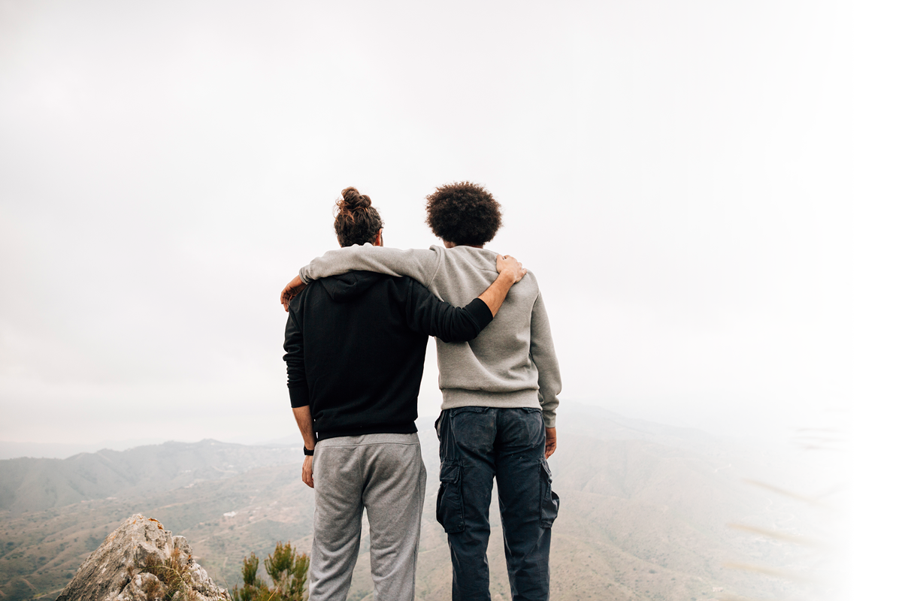
TO SUPPORT FRIENDS HAVING A HARD TIME

Slide 2
WOULD YOU RATHER
Have your favorite food every day for a year
Have your favorite dessert every day for a year

Slide 3
OBJECTIVES
Discuss how you can make a choice to support a friend who is going through a hard time
Learn about the different ways you can be a supportive friend
Reflect on why is it important to support someone

Slide 4
SUPPORTING SOMEONE WHO IS GOING THROUGH A HARD TIME.
Sometimes people we care about go through hard stuff. This could look different for everyone, but some examples may include:
Losing someone they love
Experiencing violence at home
Experiencing mental health issues
Being treated poorly by peers

Slide 5
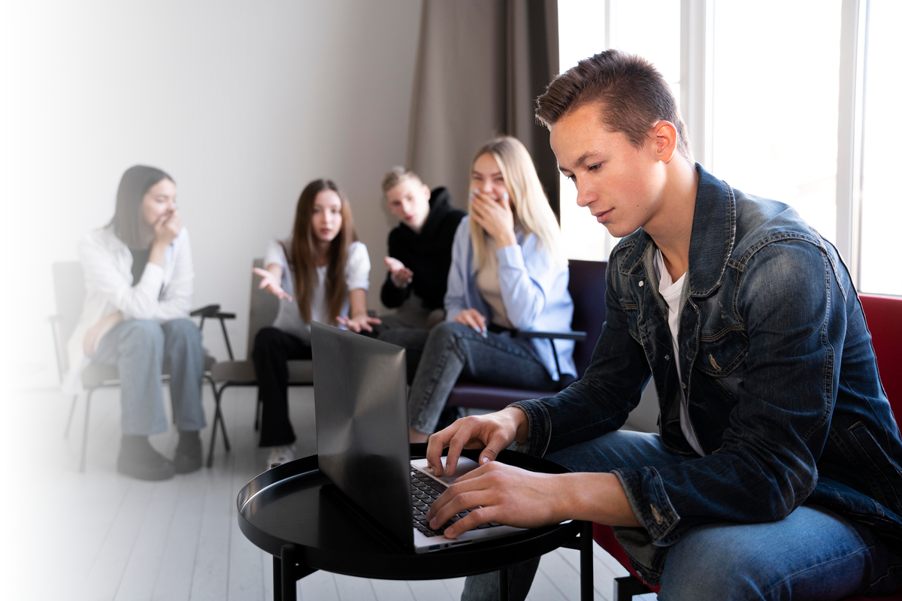
DISCUSSION
What other ways can folks experience having a hard time?

Slide 6
WHAT TO LOOK FOR
Recognizing if someone is going through a hard time may be difficult.
The best way to identify if they might be going through a hard time is by observing their behavior.
Changes in behavior, emotional and mental state can be an indication that they are not doing okay.

Slide 7
WHAT TO LOOK FOR
Poor or risky choices
Becoming easily irritated
Isolation
Engaging in self-harm
Loss of appetite
Insomnia
Over-sleeping
Lack of hygiene
Fear
Anger
Guilt
Shame
Anxiety
Depression

Slide 8
DISCUSSION
Have you ever seen or noticed anyone you care about exhibiting any of these signs?

Slide 9
MAKE A CHOICE TO SUPPORT YOUR FRIEND
Check in on people. Here are some helpful tips:
Offer to talk to them, making sure you do more listening than talking.
Do not judge
Validate their feelings
Believe them
Offer resources
Be sure to follow up

Slide 10
DISCUSSION
Not everyone wants to talk when they are having a tough time.
If your friend doesn't want to talk, what else can you do together?

Slide 11
HOW CAN YOU SUPPORT SOMEONE
Notes:
https://youtu.be/frSClA4GUMM

Slide 12
DISCUSSION
Why is it important to support someone who is going through a hard time?
What do you do when you are going through a hard time?

Slide 13
CHECK OUT
What will you do for yourself today?
Time with loved ones
Read your favorite book
Take a walk outside
Listen to
music
Drink some water

Slide 14
Committed to fostering a safe and respectful District, school and community culture where the seeds of peace and justice are sown so that all students and staff can lead safe, purposeful and academically fruitful lives.
Connect with us at bit.ly/LAUSD-HRDE

